Slide 1


Session 6
Python Syntax - 1
FUNCTION

Slide 2
Learning Outcomes
Introduction to Functions
Function definition
Passing in arguments
Return keyword
Scope

Slide 3
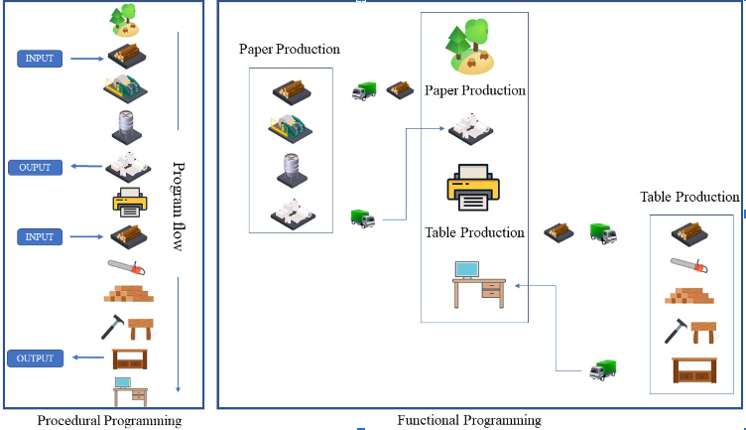
Procedural Vs. Functional Programming

Slide 4
In the previous image, the left-hand side block represents a procedural programming approach. And we can make out that procedural programming for big or multiple tasks can become very complicated. So we go for an alternate approach the functional programming.
In functional programming, we can split the code into 2 parts
main program
functions
Each function has a unique name which is used by the main program to call the function so that the task defined inside that function can be executed. In the above image, we have split the procedural code into 2 functions and a main program. This makes the code look a lot cleaner. The main program calls the function name and gives the raw input so that the function can process the input and return some output.
The Input and Output functionalities are optional.
Another advantage of using function is code reuse. If we refer to the above image of functional programming since we have defined a function called paper production every time the main program wants paper it can call the function name. If the same thing was to be achieved using procedural programming we would have to copy and paste the entire paper production tasks. This return increases the code size.

Slide 5
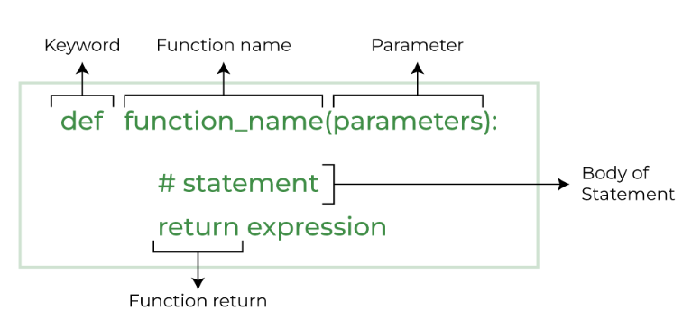
Function definition
Function Syntax
def name_of_function(arg1,arg2):
# Do stuff here
# Do stuff here
# Do stuff here
return statement #Return desired result
Function Syntax :

Slide 6
A simple print 'hello world' function
def say_hello():
print('hello')
print('world')
We will get no output when we run the above cell. All that we are doing is function definition.
The def in the function syntax stands for definition. we are supposed to call the function to run the lines of code in the function. Calling a function simply means typing the name of the function followed by open and close brackets.
say_hello()
hello
world

Slide 7
Arguments or parameters
NOTE: Arguments and parameters are the same thing More often than not we will be required to give input to the function so that the function can act on the input and give us a desired output.
Arguments are nothing but variables defined in the function definition. We assign values to these variables when we call the function.
If the function definition argues it is mandatory to give a value to that argument while calling the function we will get an error . The number of values in the bracket should be equal to the number of argument variables in the function definition.
def my_add(a,b,c):
print(a+b+c)
my_add(10,100,1000)
1110
.

Slide 8
Using return
Let's see some examples that use a return statement. return allows a function to return a result that can then be stored as a variable, or used in whatever manner a user wants.
def add_10(x,y):
z = x+y
return z
a = add_10(4,5)
print(a) Output : 9
The obvious question in your mind is why would we use a return statement when we could have printed the output in the function itself. Yes, We could have done that but what if we are using the function just to do some operation and we want to use the value of the calculated output outside of the function.
Input function allows Python to take in input from users While taking inputs we have an option to prompt the user.
NOTE: Functions will always have open and close brackets
input("enter a number : ")
enter a number: 1000
'1000'
The above line of code does not make sense as we are taking input from the user and not storing it anywhere
To store data we need to use variables

Slide 9
Scope in python
A variable is only available from inside the region it is created. This is called scope.
1. Local scope: A variable created inside a function belongs to the local scope of that function, and can only be used inside that function.
2. Global scope: A variable created in the main body of the Python code is a global variable and belongs to the global scope. Global variables are available from within any scope, global and local.
To keep things simple all we need to know is that a variable that is defined inside a function only exists inside the function. So for the function to be able to get data out we have to use return statements and store the resulting output into a new variable when calling the function.

Slide 10
REVISION
1. Function definition
2. Passing in arguments
3. return keyword
4. scope
HOMEWORK
TASK 1-Write a function that accepts a single argument and check if it is a Palindrome
The function should return True or False depending on the result
Ex. of a palindrome: MALAYALAM
TASK 2- Write a function that accepts a single argument and prints the factorial of the passed number
TASK 3-Define a function to determine if a number is prime or even

Slide 11
HOMEWORK SOLUTION
#TASK 1:
def isPalindrome(s):
new_s = s[::-1]
return new_s
s = "malayalam"
ans = isPalindrome(s)
if ans == s:
print("Yes")
else:
print("No")
Yes
HOMEWORK SOLUTION
#TASK 2:
def fact(n):
fact = 1
for i in range(1,n+1):
fact = fact * i
print(fact)
n = int(input("enter your number "))
fact(n)
enter your number 5
120

Slide 12
#TASK 4 Create a function to convert "Fahrenheit" to "Celcius"
#TASK 5 Write a function that prints the Fibonacci series up to the passed argument number
#TASK 6 Write a Python function to find the Max of three numbers
#TASK 7 Write a Python function to check whether a number falls in a given range
#TASK 8 Write a Python function that takes a list and returns a new list with unique elements of the first list.
#TASK 9 Write a program to create function calculation() such that it can accept two variables and calculate addition and subtraction. Also, it must return both addition and subtraction in a single return call.

Slide 13
THANK - YOU

